Slide 1
Types of Research
DR. MD. MAHBUBUR RAHMAN
MBBS, M. Phil, MSc. (Biotechnology),PhD
Associate Professor
DEPT. OF BIOCHEMISTRY
RAJSHAHI MEDICAL COLLEGE

Slide 2
Types of Research
The basic types of research are as follows
Descriptive vs. Analytical
Applied vs. Fundamental
Quantitative vs. Qualitative
Conceptual vs. Empirical
Some Other Types of Research

Slide 3
Research Methods versus Methodology
Research methods or techniques refer to the methods the researchers use in performing research operations
Research methodology is a way to systematically solve the research problem. It may be understood as a science of studying how research is done scientifically.

Slide 4
Researchers not only need to know how to develop certain indices or tests, how to calculate the mean, the mode, the median or the standard deviation or chi-square, how to apply particular research techniques, but they also need to know which of these methods or techniques, are relevant and which are not, and what would they mean and indicate and why

Slide 5
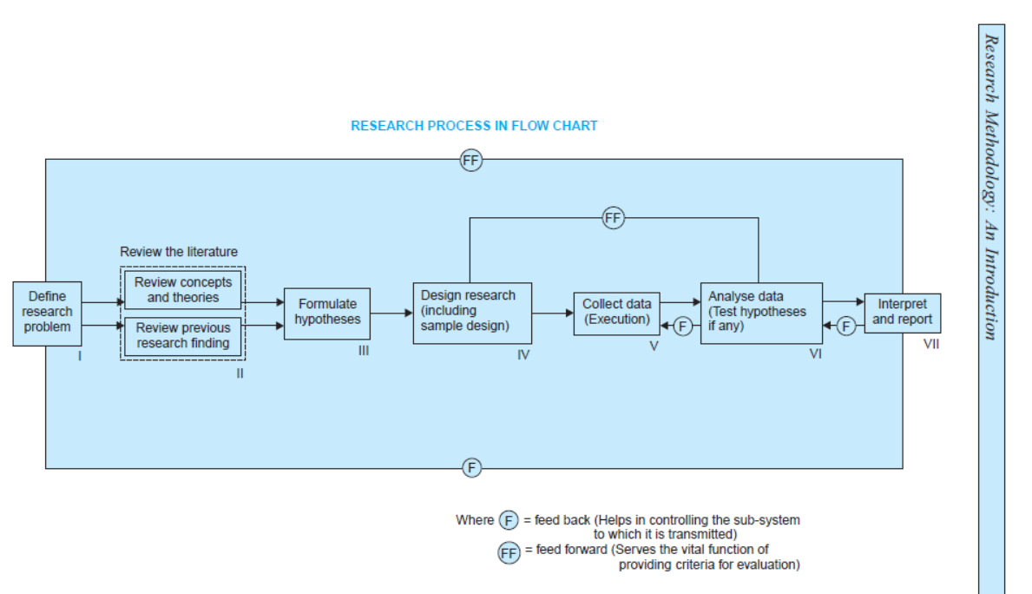

Slide 6
A good design is often characterized by adjectives like flexible, appropriate, efficient, economical and so on. Generally, the design which minimizes bias and maximizes the reliability of the data collected and analyzed is considered a good design. The design which gives the smallest experimental error is supposed to be the best design in many investigations.

Slide 7
Similarly, a design which yields maximal information and provides an opportunity for considering many different aspects of a problem is considered most appropriate and efficient design in respect of many research problems. Thus, the question of good design is related to the purpose or objective of the research problem and also with the nature of the problem to be studied. A design may be quite suitable in one case, but may be found wanting in one respect or the other in the context of some other research problem. One single design cannot serve the purpose of all types of research problems.

Slide 8
A research design appropriate for a particular research problem, usually involves the consideration of the following factors:
(i) the means of obtaining information;
(ii) the availability and skills of the researcher and his staff, if any;

Slide 9
(iii) the objective of the problem to be studied;
(iv) the nature of the problem to be studied; and
(v) the availability of time and money for the research work.

